Slide 1



Database Project Proposal:
Fantasy Football Manager
PRESENTED BY
ANDREW PERRONE - 1315988
SRI SAKTICHARAN - 1337576
AQIB AHSAN - 1333611

Slide 2


Goal:
To create a Fantasy Football/Soccer Manager database that:
Enables users to access information about real-world English club teams including player and team statistics, fixtures, and league information
Enables user to manage their fantasy football/soccer leagues and teams

Slide 3


Importance:
Millions of people around the world play and enjoy watching football/soccer. Fantasy Football websites not only provide a fun way to engage with the sport but also provide the football fans with real world information on upcoming games. Centralizing data relevant to the league allows players to make better decisions on updating their fantasy teams according to the live performances of the players.

Slide 4
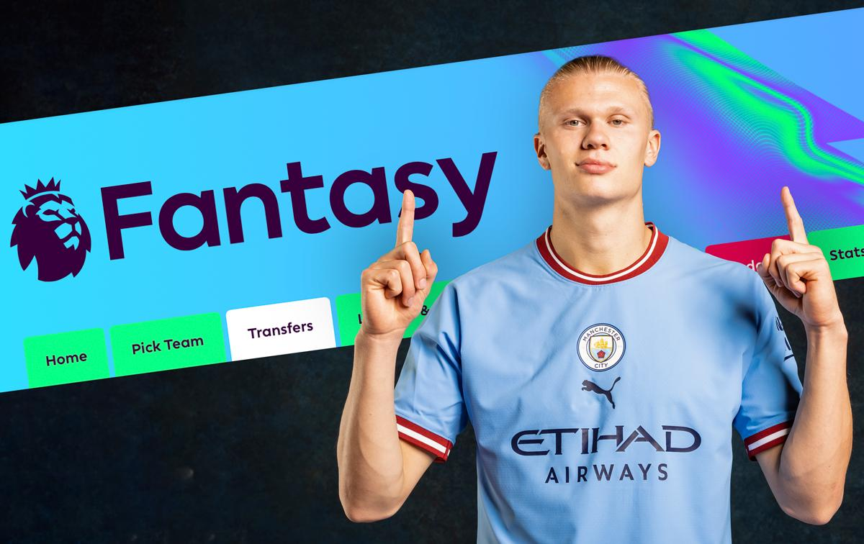
Expected Results:
A database containing all relevant information and statistics from the Fantasy Premier League website
(Potentially) A user-friendly website/application to access the data and manage leagues and teams

Slide 5

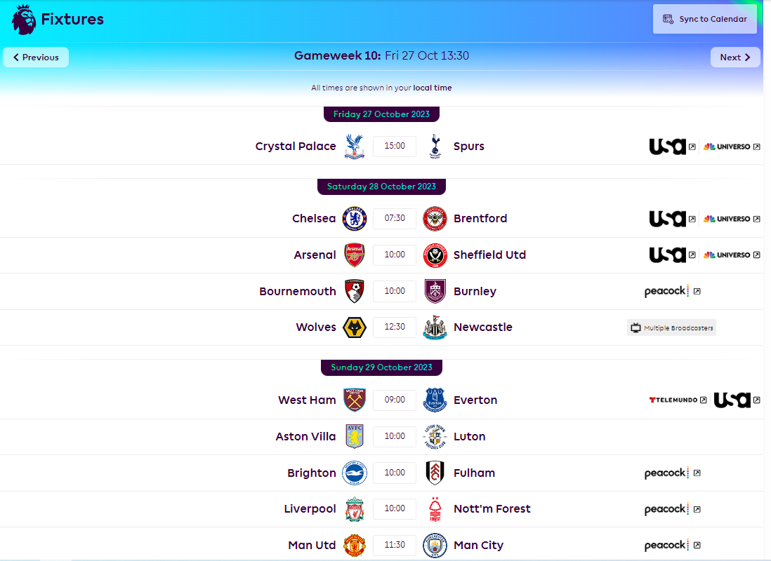
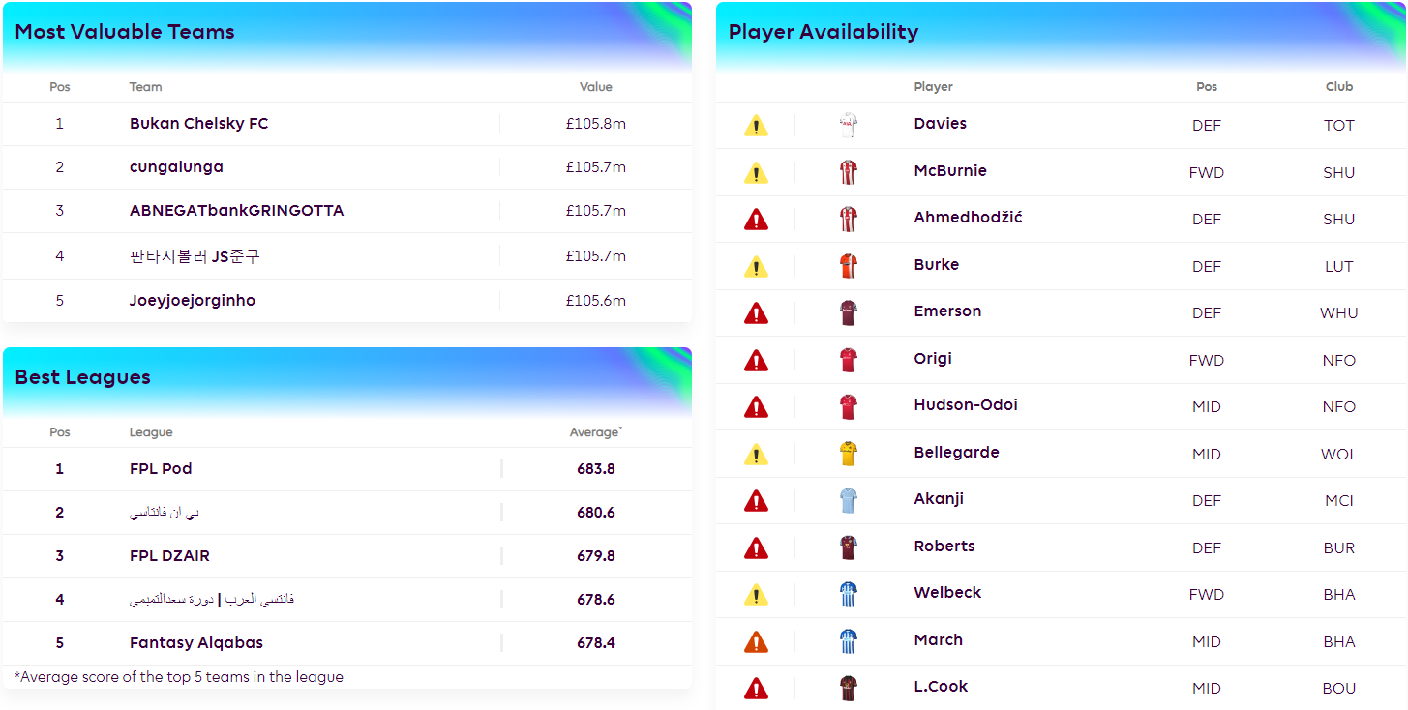
Database Functions:
Searches:
Team statistics
Player statistics
Fixture information (Matches)
Creation and Management:
User Accounts
Leagues
Teams
Player Drafts

Slide 6
Data Scale:
Players: Hundreds of players and their statistics
Teams: 20 teams and their statistics
Fixtures: Multiple fixtures per team, per season (each fixture links two teams)
User Data: User accounts, leagues, teams, and player selections
Approximate Database Size:
Less than 5MB
Data Sources:
Player and team statistics from the fantasy.premierleague.com website
User data will be generated
Statistics would normally be updated automatically (but this is out of our project’s scope)

Slide 7

$
Front-End Design:
User-Friendly Website or Application: A user-friendly interface for account creation, league/team management, and player transfers
Search Functionality: Users can search player and team statistics and access fixture information

Slide 8

Schedule:
Visualize Schema:
Data Management:
Determine Desired Data
Identify what data to store
Define Relations and Attributes
Determine the tables and their attributes
Define Primary and Foreign Keys
Set key constraints for data integrity
Create SQL Queries
Develop SQL queries for various functions
Determine Relevant Data
Decide what data to collect from the FPL website
Create Data Retrieval Scripts
Develop scripts to fetch player, team, and fixture data
Generate User Data
Create a script to generate user accounts, leagues, and teams
Input Data to Database
Automate the process of populating the database with collected/generated data

Slide 9
Schedule (continued):
Testing:
Front-End Design:
Validate Data Integrity
Ensure that data is correctly and consistently stored.
Test and Debug Queries
Verify that SQL queries perform as expected.
Evaluate Project Completeness
Assess if the project meets its objectives.
Determine Required Functionality
Define the features and user interactions.
Design
Plan the user interface and user experience.
Create
Develop a user-friendly website or application
Further Testing/Debugging
Ensure the front-end functions correctly
Final Evaluation
Assess the final product for usability and functionality

Slide 10

$
Thank You!

